Slide 1
Nigeria economy
BY GROUP 2

Slide 2
Introduction to the Nigeria Economy Dataset
The Nigeria Economy dataset spans from the year 1990 to Year 2023, It comprises key factors influencing the Economy of the most populous country in the West Africa.
It’s an Econometrics Dataset that measure the performance of each President/HOS Head Of State.
DATA SOURCE:
KAGGLE

Slide 3
Inflation
This tracks the annual percentage change in the general price level of goods and services. High inflation rates can impact purchasing power and economic stability.
Unemployment
The unemployment rate indicates the proportion of the labor force that is actively seeking employment but remains jobless.
Government Debt
This contains data on Nigeria’s public debt, including both domestic and external debt.
Sectorial
These are the Sectors which contribute to the Economy of Nigeria, these are Industry, Services and Agriculture.

Slide 4
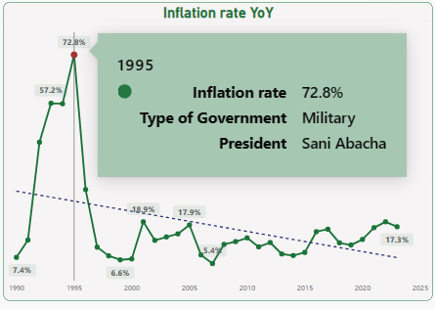
At 72.8%, 1995 had the highest Inflation rate and was 1,248.89% higher than 2007, which had the lowest Inflation rate at 5.4%. 1995 had the highest Inflation rate at 72.8%, followed by 1993 and 1994. 2007 had the lowest Inflation rate at 5.4%. 1995 accounted for 11.86% of Inflation rate. Across all 34 Year, Inflation rate ranged from 5.4% to 72.8%.

Slide 5
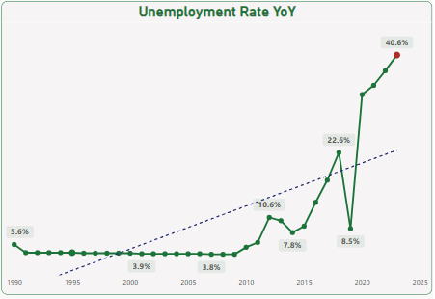
The unemployment rate in Nigeria remained relatively low, average percentage of 4.0%, until 2009.
From 2010 onwards, there was a gradual increase, with the rate exceeding 10% between 2010 to 2012 and rising to 22.6% by 2018. A slight decline occurred in 2019, but unemployment surged again in 2020 reaching 33.6%, and at it peak in 2023 with 40.6%

Slide 6
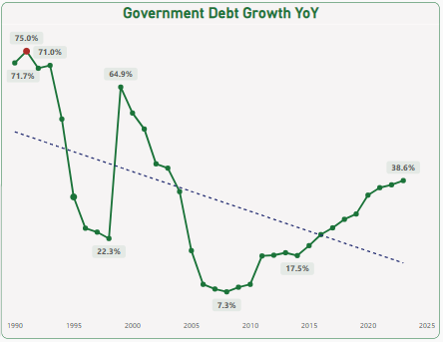
The level of government debt in Nigeria fluctuated over the years. Initially high above 70% from 1990 to 1993, it gradually decreased to a range of 30% to 22% between 1995 and 1998.
A sharp increase occurred in 1999 to 64.9%, possibly due to increased borrowing or fiscal policies. From 2000 to 2008, government debt declined steadily, dropping below 8%(the lowest).
However, it began to rise again from 2010, reaching 38.6% in 2023, signaling potential fiscal challenges and increased borrowing.

Slide 7
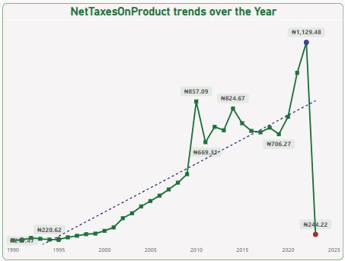
Net taxes on products exhibited a pattern of growth followed by a decline in 2023 to the same amount it was in the year 1999 #244.22 .
This indicates a decrease in government revenue from taxes on goods and services, potentially reflecting changes in taxation policies or economic downturns affecting consumption and production.

Slide 8
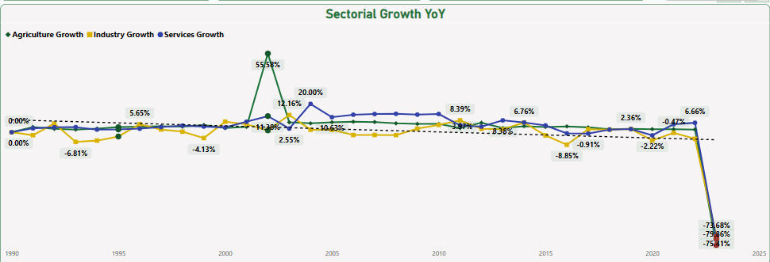
Over the past 3 decades, Nigeria’s economy witnessed shifts in the growth of its different sectors Agriculture, Industry, and Services.
Although all sectors generally follow the same growth pattern, the agricultural sector experienced a tremendously growth rate of 55.58% in 2002.
In the year 2003, all sectors returned to same pattern.
There was a lousy decline across all sectors, with the average growth rate dropping from 3% in 2022 to
-74% in 2023.

Slide 9
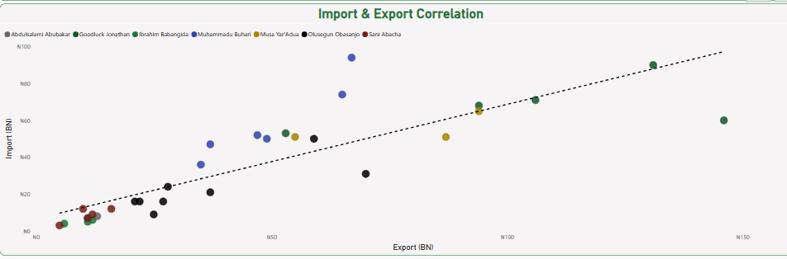
There is a correlation between imports and exports for each President/Head of State (HOS).
However, there are some years, such as 2011, 2013, and 2014, where there is a disparity between exports and imports.
During President Goodluck Jonathan's tenure, imports amounted to 60 billion Naira in 2012, while exports reached 146 billion Naira.

Slide 10
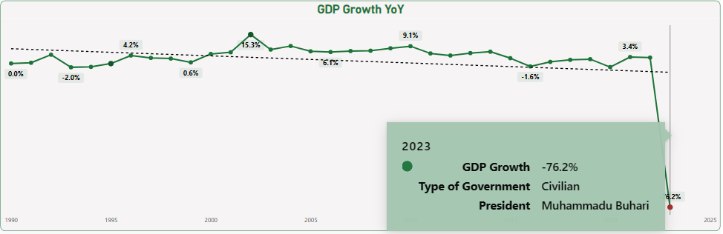
At 15.3%, 2002 had the highest GDP Growth and was 120.11% higher than 2023, which had the lowest GDP Growth at -76.2%. Across all 34 Year, GDP Growth ranged from -76.2% to 15.3%.

Slide 11
Sectorial contribution to GDPs
17.9%
17.1%
47.4%
2023
2023
2023
Agriculture Contribute
Industry Contribute
Services contribute
In the year 2023 against 88.9% in 2022
In the year 2023 against to 66.1% in 2022
In the year 2023 against 192.7% in 2022

Slide 12
Recommendation
Promote Fiscal Responsibility: Exercise prudence in fiscal management to prevent the risks associated with mounting government debt. Implement strategies to reduce debt burdens by optimizing resource allocation towards strategic priorities such as infrastructure development, education, and healthcare.
Prioritize Human Capital Development: Recognize human capital as a foundation of sustainable economic development. Invest in education, skills training, and healthcare to empower citizens, enhance productivity, and foster social inclusion.

Slide 13
SUMMARY
This is an Econometric dataset, of the Nigeria Economy from the year 1990 to 2023. Covered the performance of each president/HOS Head of state over the past 34 years.

Slide 14
THANK YOU GUESTS
chiamakacobinwa@gmail.com
harwofe16@yahoo.com
estherifeoluwa672@gmail.com
ndianefochinonso6@gmail.com
justiceofokansi@gmail.com
olabintanwhite@gmail.com
igbasanabimbola@gmail.com
okam.mercy1@gmail.com
ojonla.2014@yahoo.com

